Slide 1
Introduction to NLP
Introduction to Deep Learning

Slide 2
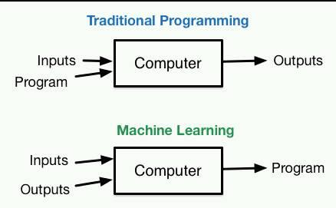
Modern AI Paradigm

Slide 3
Neural Networks
Remember Logistic Regression?
Input: vector of features
Output: classification decision
One-layer LR (maxent model) is a simple Neural Network
Neuron (perceptron): output is a non-linear combination of the inputs

Slide 4
Introduction to NLP
Perceptrons

Slide 5
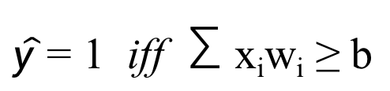
Perceptron
$\hat{y}$ = 1 iff Σ x_{i}w_{i} ≥ b
y
w₁
w₄
w₂
w₃
x₁
x₂
x₃
x₄

Slide 6
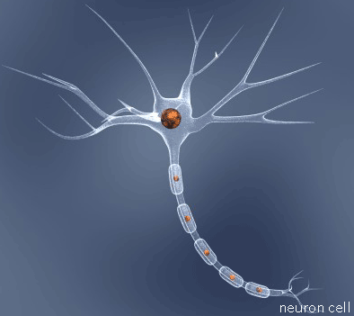
The Perceptron
A simple but very important (discriminative) classifier
Model of a neuron
Input excitations
If excitation > inhibition, send an electrical signal out the axon
Earliest neural network
invented in 1957 by Frank Rosenblatt at Cornell

Slide 7
Perceptron Idea
Input
-1
x₀
no
w₀
x₁
w₁
Σ
> threshold?
w₂
x₂
yes
1
Question: Where can we get these weights?

Slide 8
Quick Reminder: Dot Products
This equation
3
x
2
y
5
z
7
3
x
2
y
5
z
can be written as a dot product of two vectors:
x
7
3
2
5
y
z

Slide 9

So we can rewrite
x₀
w₀
x₁
w₁
Σ
w₂
x₂
as a dot product of two vectors
$$\overset{⃑}{w}∙\overset{⃑}{x}$$

Slide 10
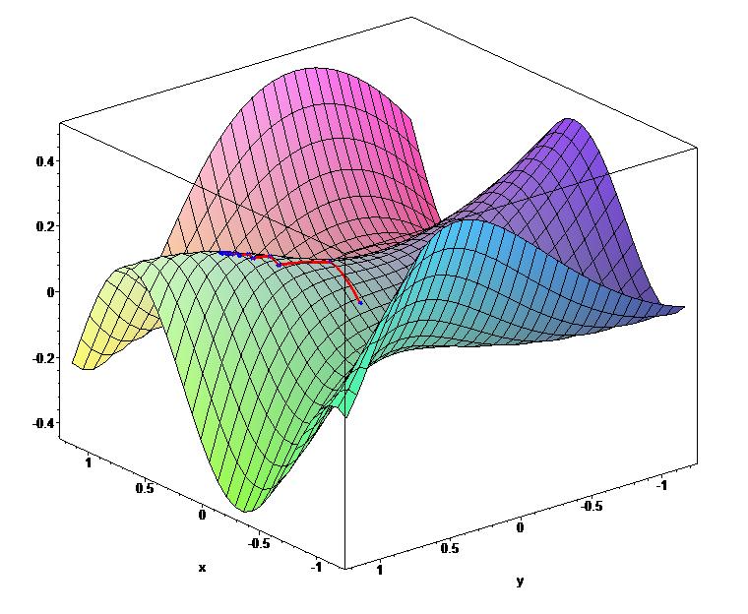
Derivatives and Gradients
https://en.wikipedia.org/wiki/Gradient_descent

Slide 11
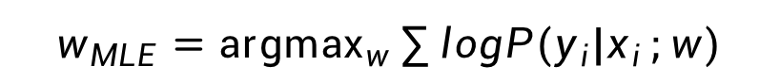
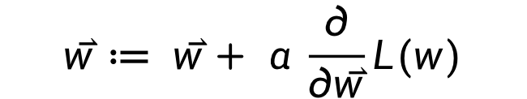
Updating Parameters
Basic approach
We want to increase the probability of the entire data set
Gradient ascent
Take the derivative of the log likelihood with respect to the parameters
Make a little change to the parameters in the direction the derivative tells you is uphill:
α here is the learning rate
how much do you want to change each time?
$$w_{MLE}={\text{argmax}}_{w}\sum{{logP(y}_{i}|x_{i}};w)$$
$$\overset{⃑}{w}≔ \overset{⃑}{w}+ α \frac{∂}{∂\overset{⃑}{w}}L(w)$$
Notes:
If you don’t know how to do this math, don’t worry. It’s not required for the course. Besides, this is what we have computers for.

Slide 12
Perceptron Algorithm
Input:
Algorithm:
Output:

Slide 13
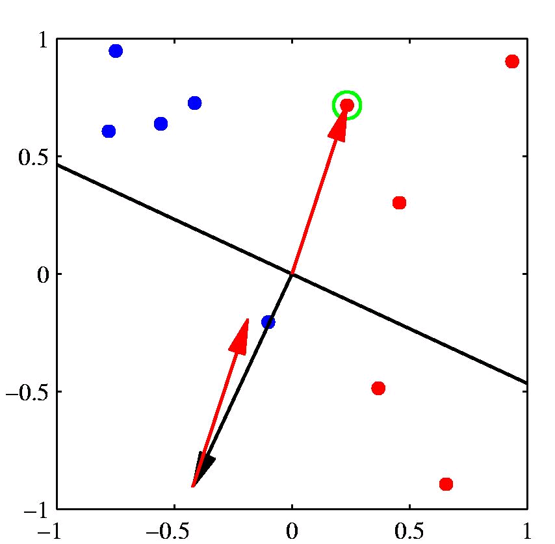
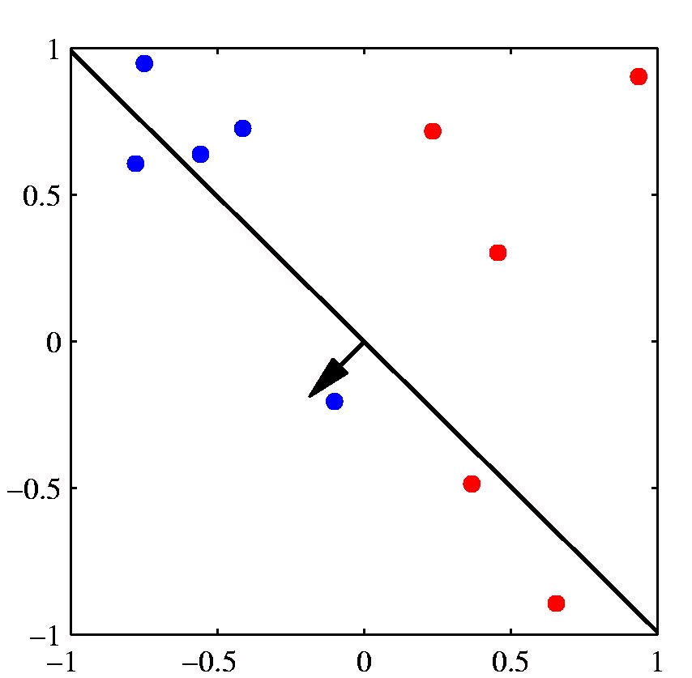
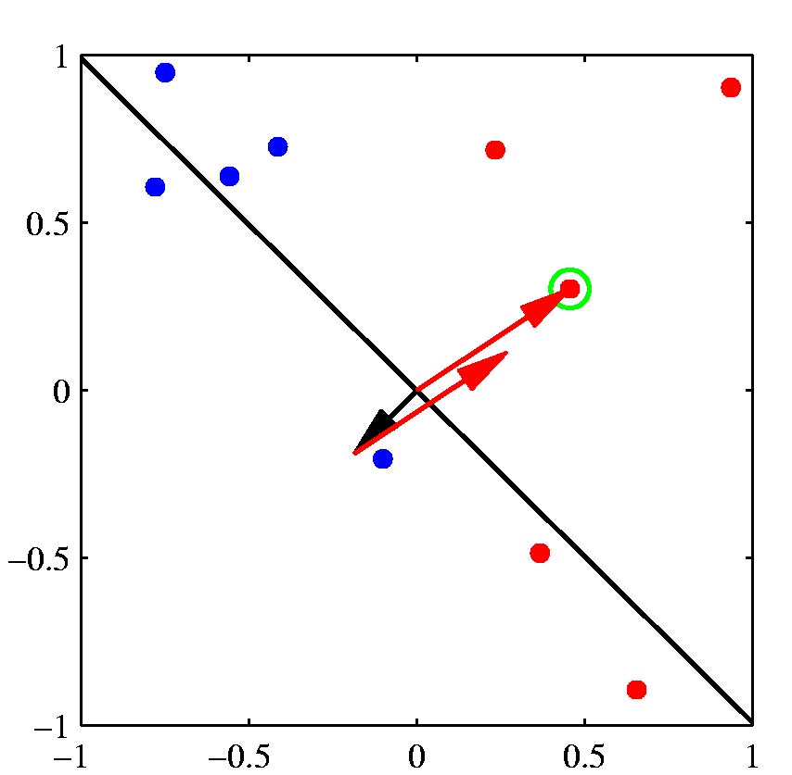
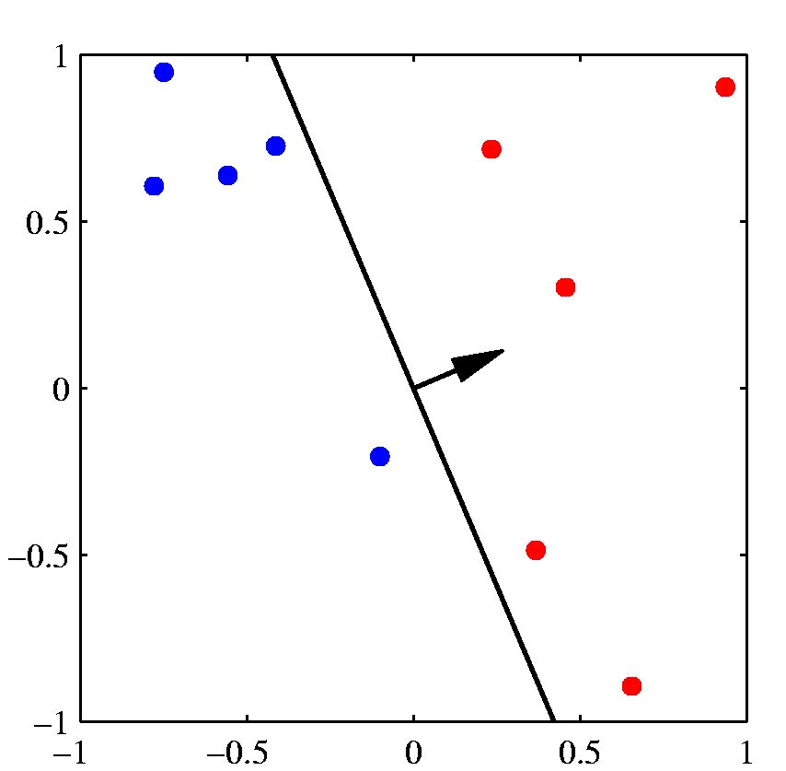
[Example: Chris Bishop]

Slide 14
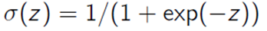
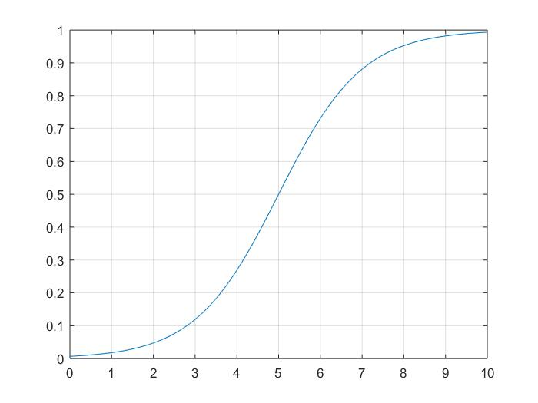
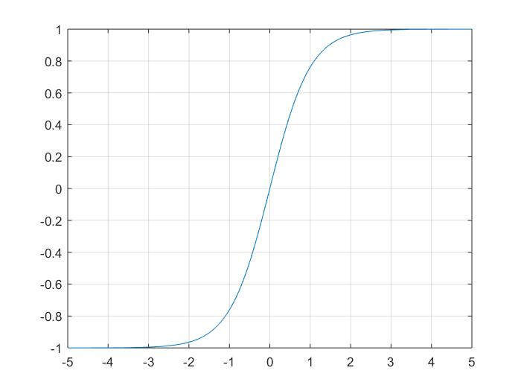
Non-linearities: sigmoid, tanh
Notes:
Jordan, M.I. (1986). Serial order: A parallel distributed processing approach.
LSTM (1997)
Predecessor to CNNs first introduced in 1980, developed in 1988, improved in 1998.

Slide 15
Multi-Layer Perceptron (Multi-layer LR)
z
[output layer]
v₁
v₂
y₁
y₂
[hidden layer]
w_{1,2}
w_{4,2}
w_{2,2}
w_{3,2}
w_{1,1}
w_{2,1}
w_{4,1}
w_{3,1}
x₁
x₂
x₃
x₄
[input layer]

Slide 16
Network with a Hidden Layer
It is a universal function approximator
It can model any continuous function (Hornik 1991)
This is not true for a simpler network
It cannot learn XOR, for example (no one-layer linear classifier can)
The deeper network can represent XOR
as a disjunction of two lower-level features
An even deeper network can also represent an arbitrary function
but with fewer nodes

Slide 17
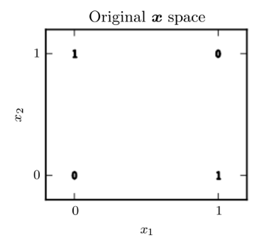
The XOR function
[[0,0], [0]]
[[0,1], [1]]
[[1,0], [1]]
[[1,1], [0]]

Slide 18
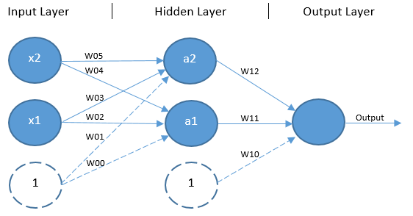
Deep Learning Helps

Slide 19
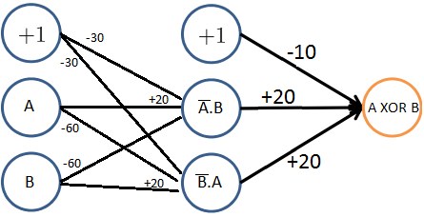
The XOR function
https://www.quora.com/How-can-we-design-a-neural-network-that-acts-as-an-XOR-gate

Slide 20
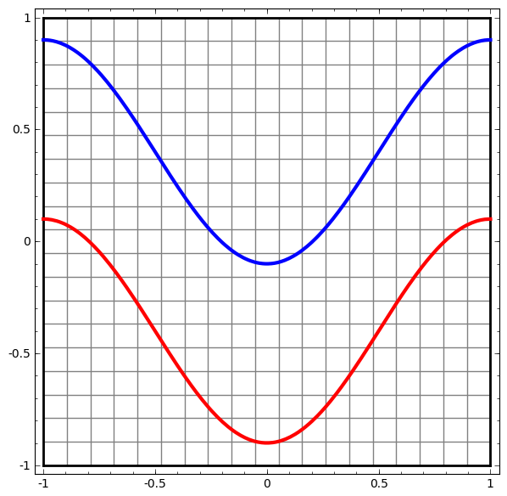
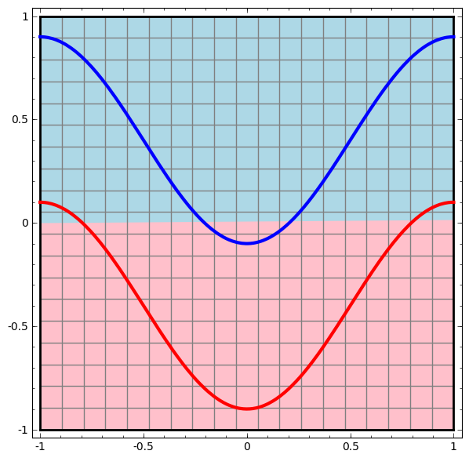
http://colah.github.io/posts/2014-03-NN-Manifolds-Topology/

Slide 21
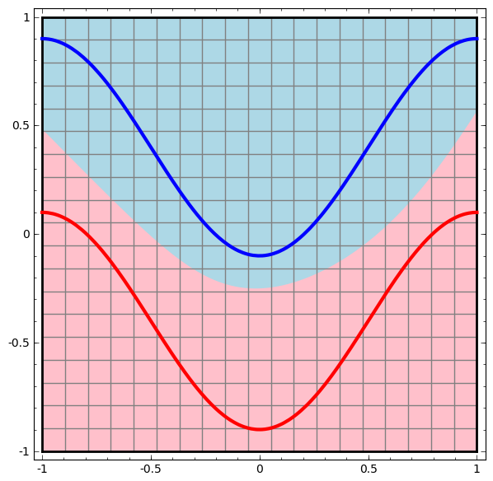
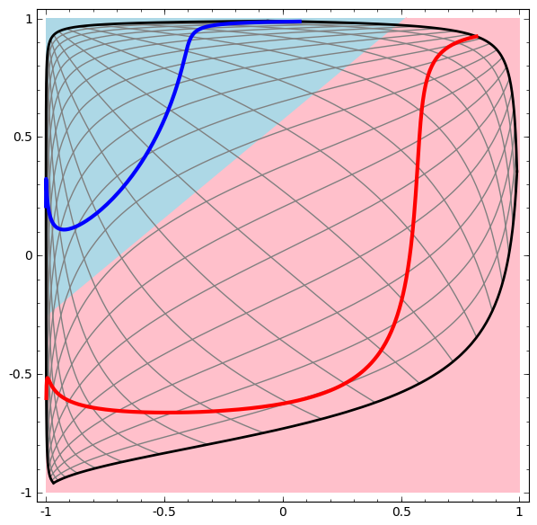

Slide 22
Multi-Layer Perceptron
x2
x1

Slide 23
Deeper Networks
Multiple layers
Input layer
Low-level feature layer
Higher-level feature layer
Output layer
Intuition
Learning features automatically
+
=

Slide 24
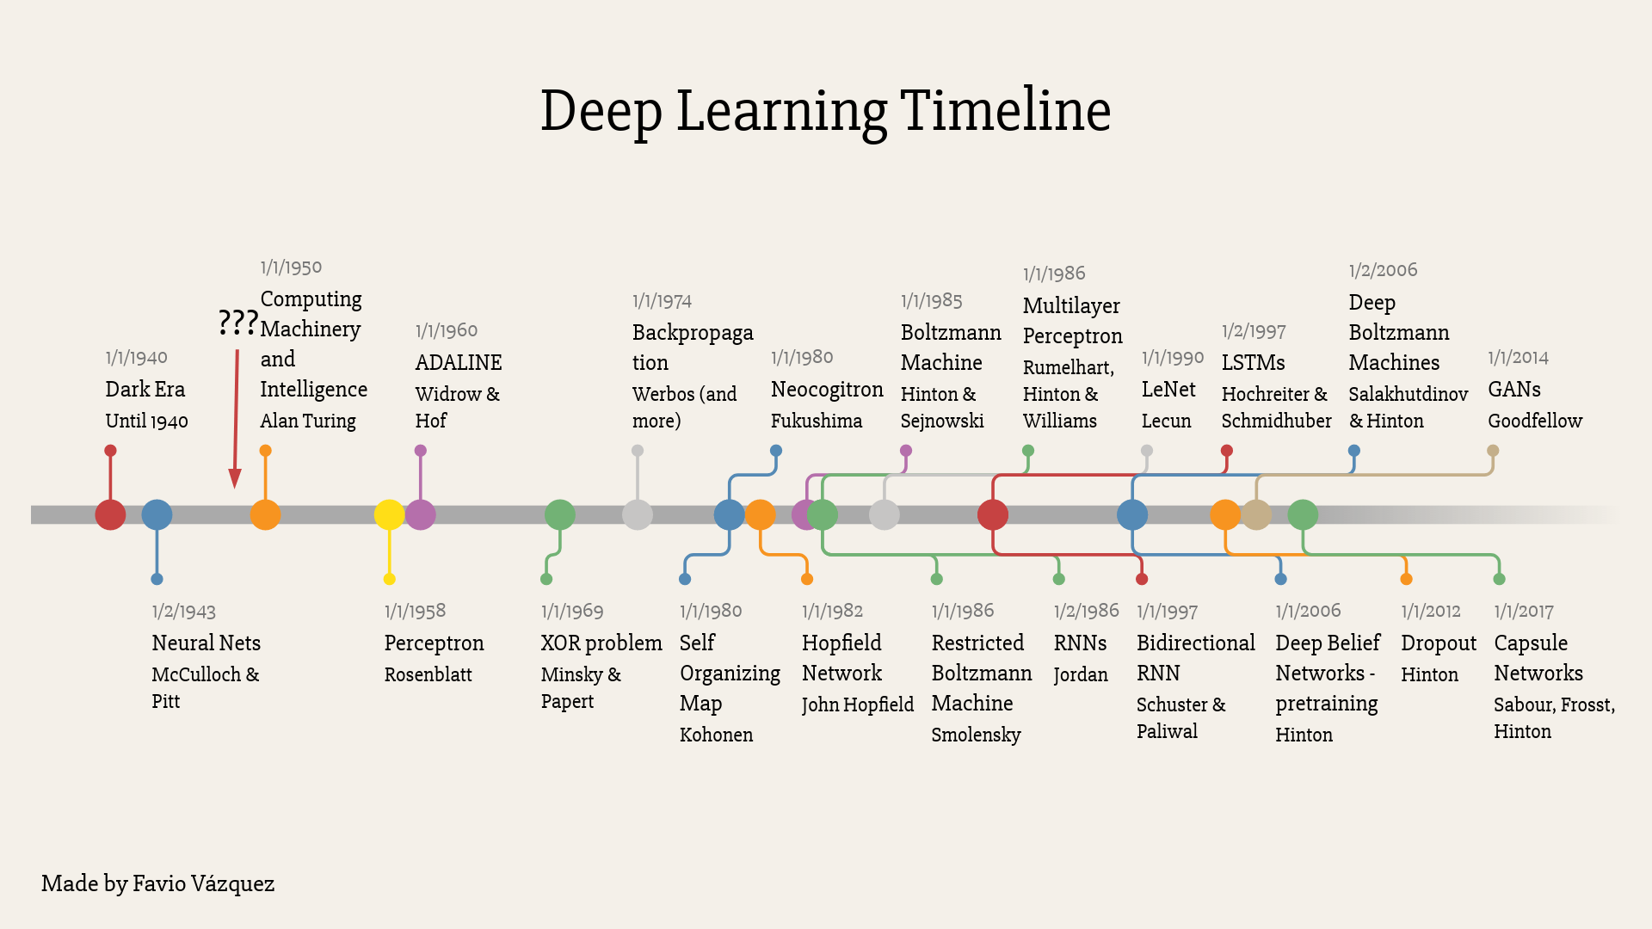

Slide 25
ImageNet
14 M images, manually labeled through crowdsourcing
20,000 categories
https://qz.com/1034972/the-data-that-changed-the-direction-of-ai-research-and-possibly-the-world/

Slide 26
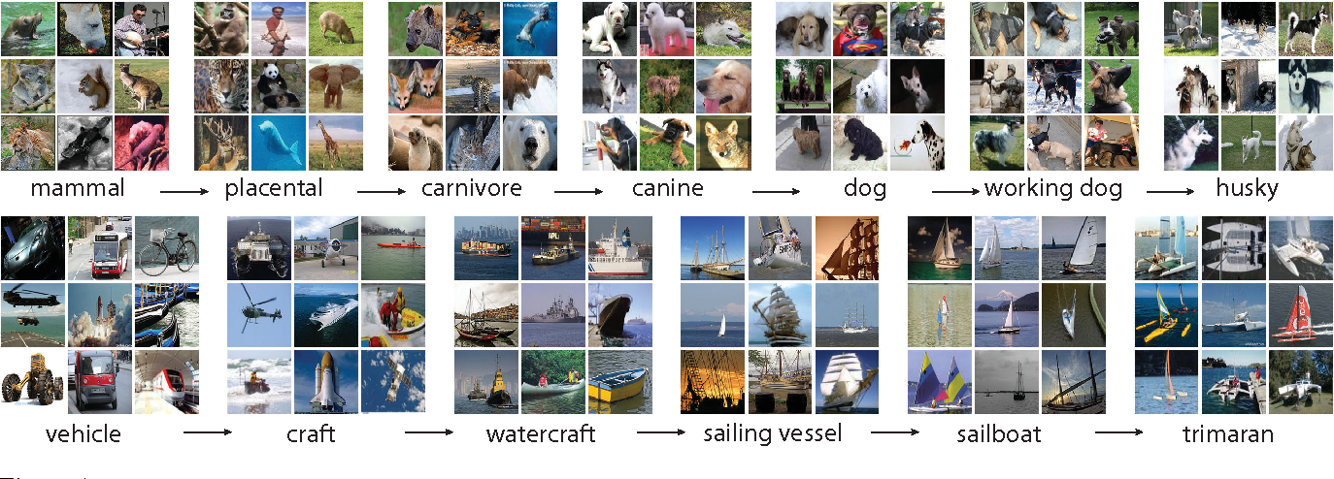
ImageNet
[Image from Deng et al. and Fei-Fei Li 2011]

Slide 27
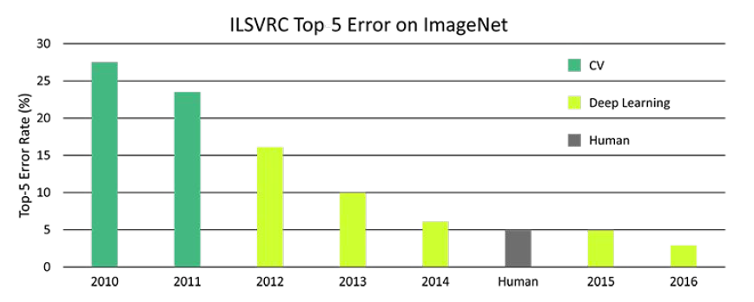
ImageNet Classification Scores

Slide 28
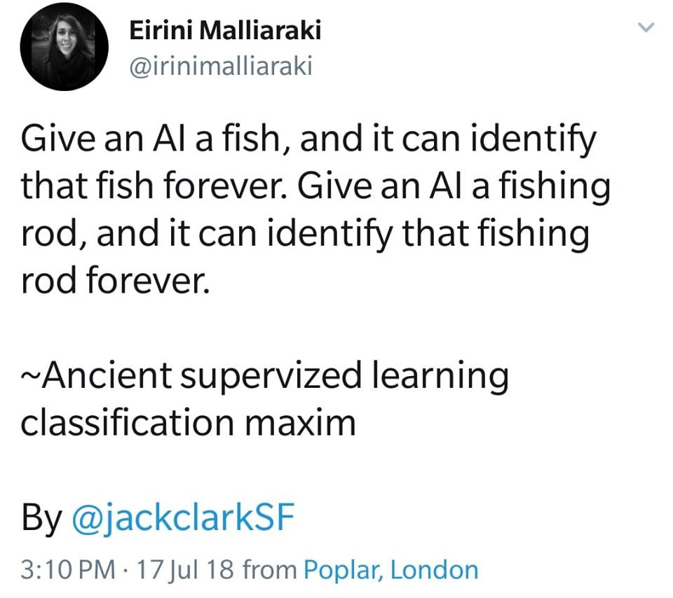

Slide 29
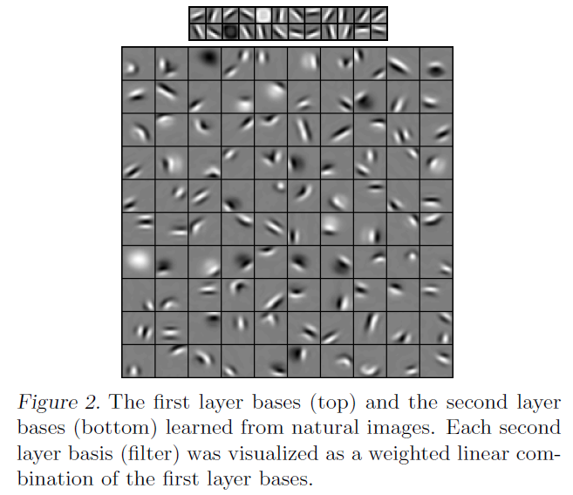
Example (from Lee et al. 2009)

Slide 30
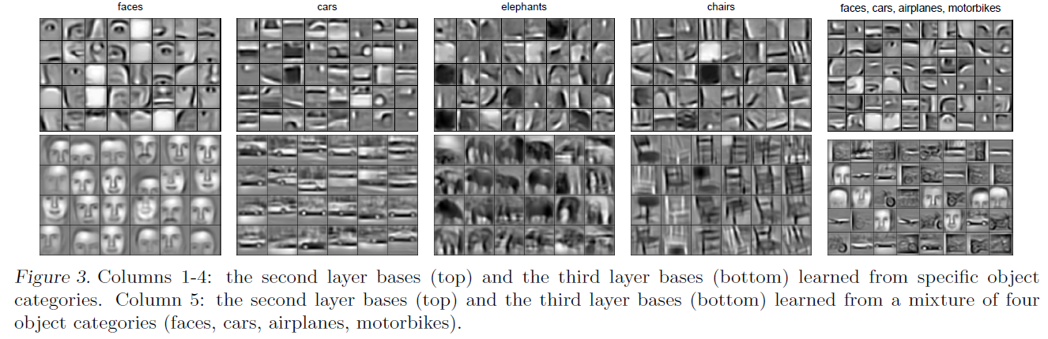
Example (from Lee et al. 2009)

Slide 31
What is Deep Learning
Architecture
Neural Networks with multiple layers
Non-linearities (e.g., sigmoid, tanh)
Use
Single-layer NN used as simple classifier
Multi-layer NN can express more complex functions and learn complex features
Hot area of research
Very popular these days, especially in speech and vision, but also in NLP
Works best with high-performance computers using GPUs and very large data sets

Slide 32
Why Deep Learning?
Amazing results
Speech: Dahl et al. 2010 – 30% improvement in WER (word error rate)
Vision: ImageNet (Krizhevsky et al. 2012) – scarily complex architecture
The big players (Google, Facebook, Baidu, Microsoft, IBM…) are investing billions in DL
The hot new thing?
Actually, many of the architectures that we’ll talk about were invented in the 1980s and 1990s
What’s new is hardware (GPU) that can use these architectures at scale
Notes:
Jordan, M.I. (1986). Serial order: A parallel distributed processing approach.
LSTM (1997)
Predecessor to CNNs first introduced in 1980, developed in 1988, improved in 1998.

Slide 33
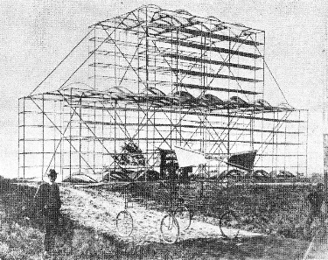

Slide 34
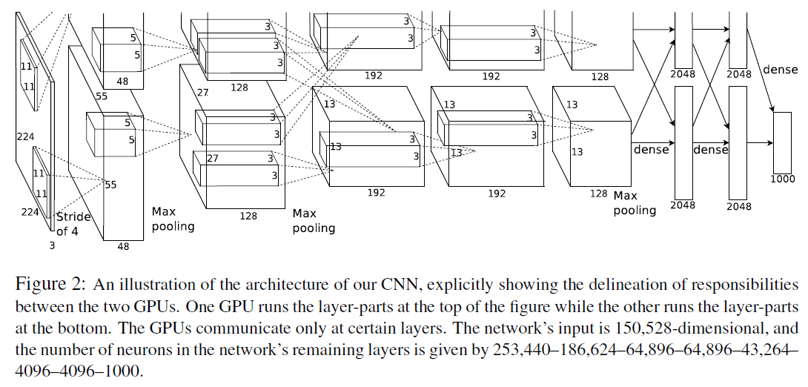
ImageNet Architecture

Slide 35
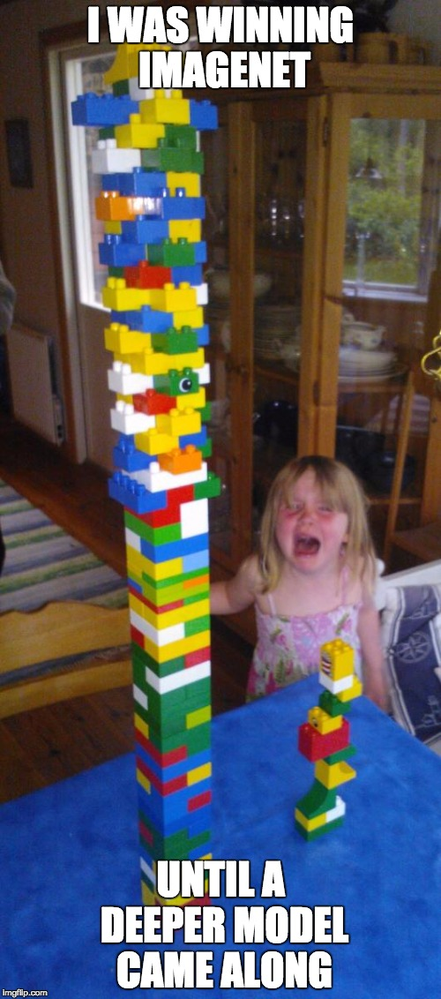

Slide 36
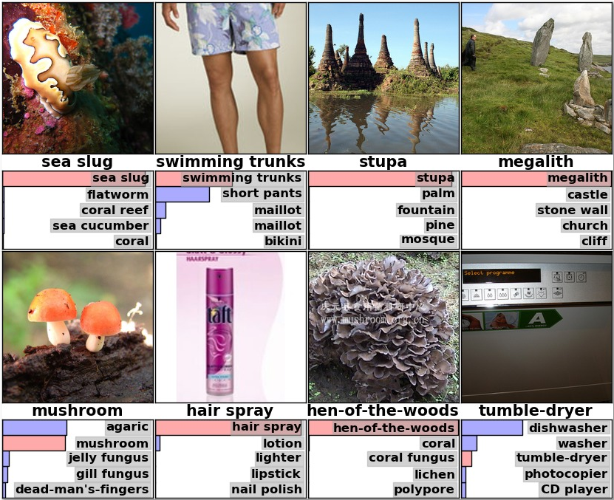
[Krizhevsky et al. 2012]

Slide 37
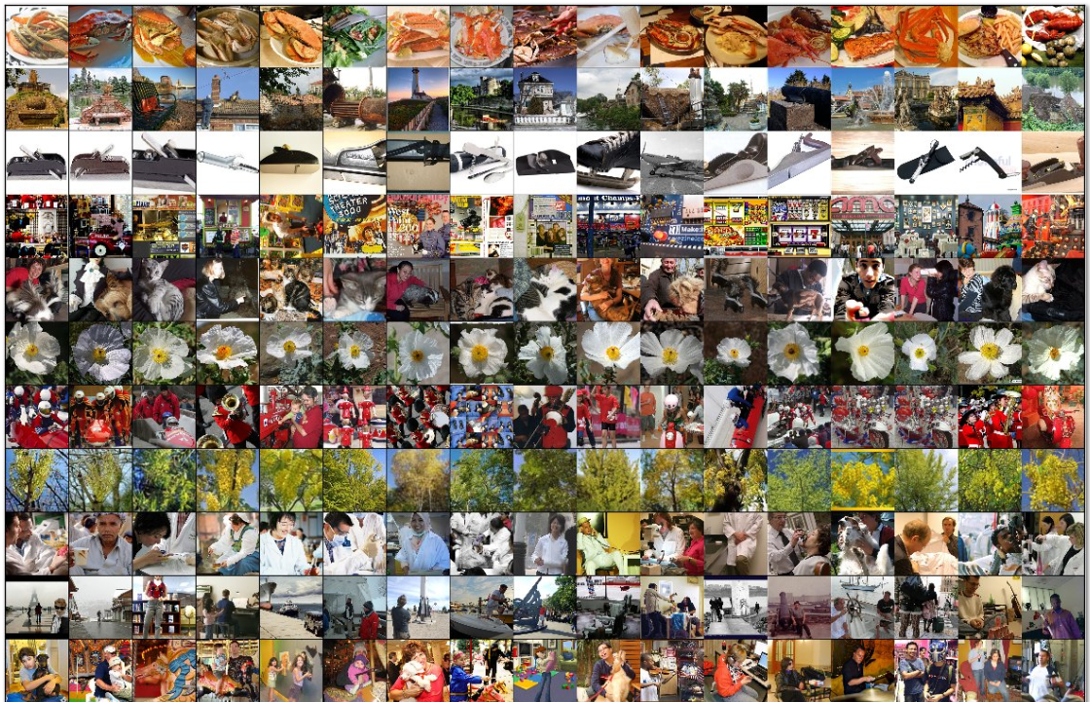
[Krizhevsky et al. 2012]

Slide 38
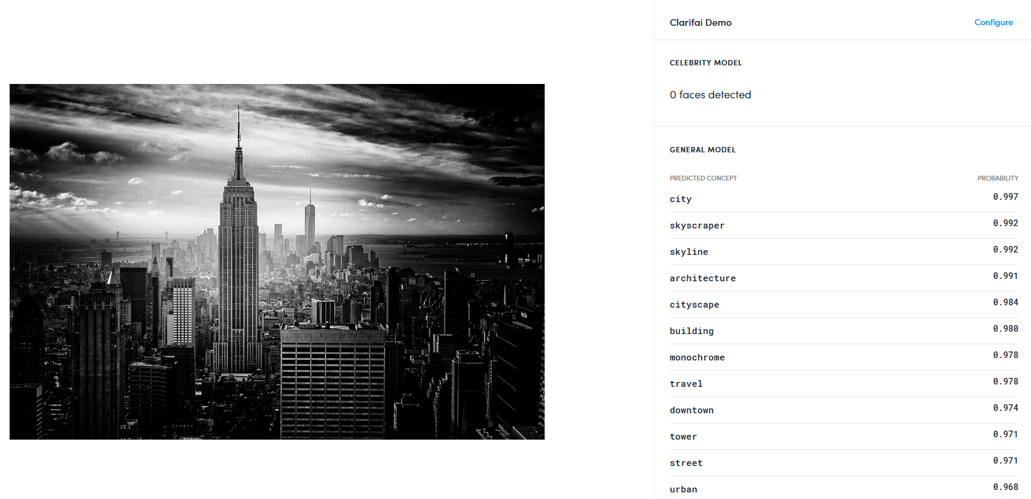
[clarifai.com demo]

Slide 39
Autoencoder
z₁
z₂
z₃
z₄
[output layer]
z = x
y₁
y₂
[hidden layer]
x₁
x₂
x₃
x₄
[input layer]

Slide 40
Autoencoder
The size of the hidden layer should be smaller than the size of the input layer.
Otherwise the hidden layer will learn the identity mapping
Minimize loss
difference between z_{i} and x_{i}
Denoising autoencoder
Add some domain-independent noise to the input
Example: rotate or stretch the image
Still try to have the output match the input
The autoencoder is closely related to SVD

Slide 41
Introduction to NLP
Deep Learning for NLP

Slide 42
Deep Learning for NLP
Input:
words, sentences, documents
Neural networks expect continuous vectors:
word embeddings (next lecture), sentence embeddings, document embeddings
For sequence of variable length
Use recurrent neural nets (RNN), e.g., LSTM

Slide 43
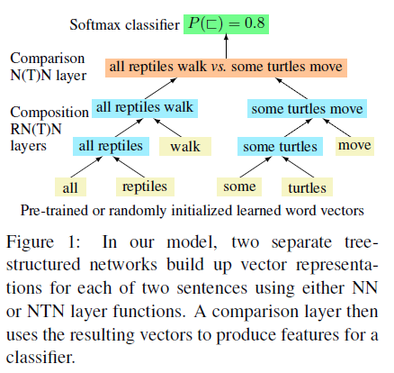
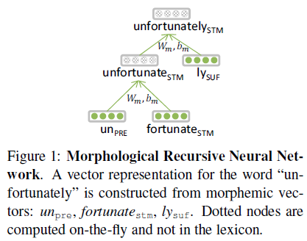
NLP Examples
[Thang et al. 2013]
[Bowman et al. 2014]

Slide 44
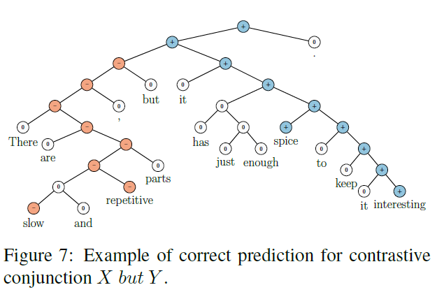
Sentiment Analysis
[Socher et al. 2013]

Slide 45
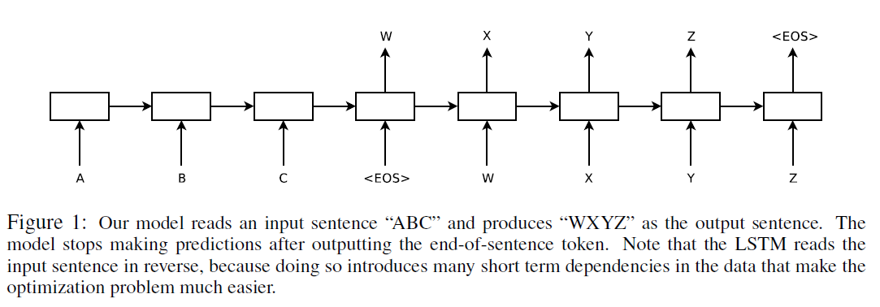
Machine Translation
Sequence-to-sequence
[Sutskever et al. 2014]

Slide 46
Coreference Resolution
[Clark and Manning 2016]

Slide 47
Input Reordering
(Botha et al. 2017)

